Slide 1

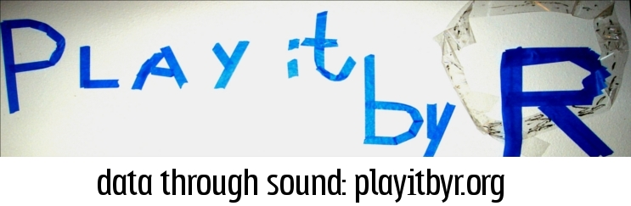
Who’s Sonifying Data and
How are they doing it?
A comparison of ICAD and
other venues since 2009
Nick Bearman & Ethan Brown
ICAD 2012
Notes:
Mention me and ethan meeting at ICAD

Slide 2

Who’s sonifying data & How are they doing it?
Who? – disciplines & collaboration
How? – software
Articles
Since 2009
29 ICAD, 22 non-ICAD
Criteria for inclusion
a sonification is created
data are used
?
Notes:
Mention me and ethan meeting at ICAD
there have been other reviews, but we wanted to focus on the people doing the sonifications and the software they used
Who? – disciplines & collaboration
How? – software
We didn’t do a formal systematic review – that’s not what we set out to do.
Articles
Since 2009
29 ICAD, 22 non-ICAD
Non-ICAD articles – ‘searched Web of Science and Google Scholar and followed up relevant references‘
Criteria for inclusion
a sonification is created (i.e. not just a discussion of a technique)
data are used (real or synthesized)

Slide 3
Who’s sonifying?
 | ICAD (29) | Non-ICAD (22)
Affiliated with Music / Music Tech dept | 85% | 68%
Affiliated with applied subject area - Physics, Biology, Engineering | 58% | 77%
Social Science Applications | 3% | 0%
Collaborations between Music/Music Tech and applied subject area | 41% | 23%
Notes:
We looked at the affiliations of the papers.
ICAD
85% (25) affiliated Music / Music Tech dept
58% (17) affiliated with applied subject area
Physics, Biology, Engineering, Human Movement Science
Physics / Biology / Engineering well represented
Only one social science application – why?
Comments
Not a lack of quantitative data
Technical knowledge? Yes & No
Lack of mature, general purpose sonification tool
41% (12) were collaborations between (Music/Music Tech) and (applied subject area)
Collaborations are important

Slide 4
Who’s sonifying?
 | ICAD (29) | Non-ICAD (22)
Affiliated with Music / Music Tech dept | 85% | 68%
Affiliated with applied subject area - Physics, Biology, Engineering | 58% | 77%
Social Science Applications | 3% | 0%
Collaborations between Music/Music Tech and applied subject area | 41% | 23%
Notes:
Comparing ICAD to non-ICAD
Non-ICAD
68% (15 of 22) affiliated Music / Music Tech dept
Less than ICAD but still a significant proportion
77% (17 of 22) in applied subject area
Tech & Health, Env Sci, Engineering, Life Science, Human Movement Sci
No social science applications
Similar reasons?
23% (5 of 22) were collaborations between (Music/Music Tech) and (applied subject area) (less than ICAD)
Collaboration with other disciplines is central to sonification.
81% (18 of 22) had some author overlap with ICAD
7 had all ICAD authors, 11 had a mix

Slide 5
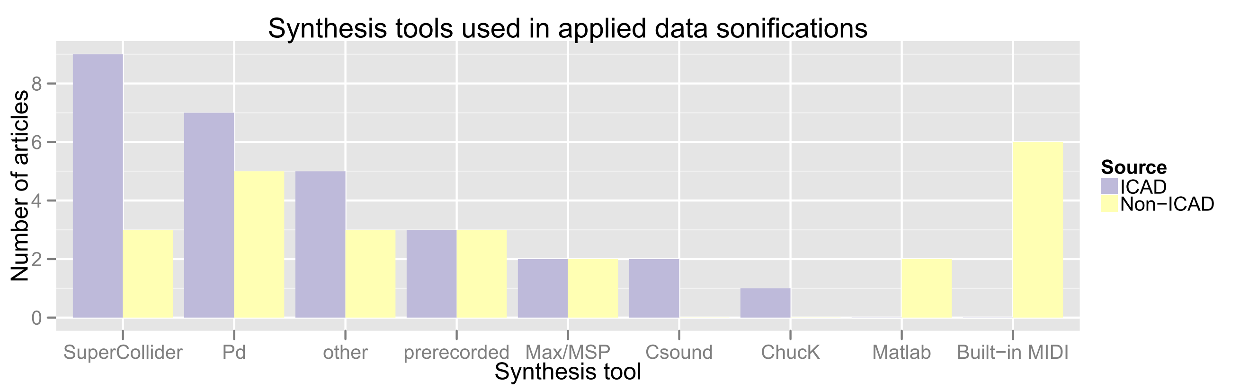
How are they doing it?
(PureData)
Sonification by:
Notes:
We categorised the articles by the tool they used for sonification.
We did create graph, but also created a sonification.
Sonified graph
Series of synthesised notes
Played in pairs for each tool, with the first (lower) note being ICAD and the second (higher) being non-ICAD
'Each note represents an article' - so if a note is played 3 times that means there were three articles for that tool
example – SuperCollider
9 ICAD, 3 non-ICAD
then play all
Did you get an idea of the data?
Show graph
Did the sonification match the graph?
Sonification by Ethan’s playitbyr package for R
ICAD – SuperCollider and Pd most popular – unsurprisingly.
‘Other’ covers a smattering of custom hardware and software
Non-ICAD – Built in MIDI most common
simple, easy to use, well supported, lots of libraries / add-ons for easy integration
Also Pd.
Other patterns – Matlab – a sound add on to an existing well used program
Why? – time limited (2005 or 2000, MIDI would be larger and Pd/ChucK would be 0).
What are we not seeing?
Comments

Slide 6
Learning something new...
Out of 22 authors on >1 publication only 5 used more than one tool
Many people stick with the same tool
Who has used (i.e. published with) more than one tool?
Notes:
Out of 22 authors on >1 publication (ICAD and non-ICAD), only 5 used more than one tool
Many people stick with the same tool
Sticking with something you know is easy, learning something new is not!
Whose used (i.e. published with) more than one tool?
What made you change tool? Or what made you not change tool?

Slide 7

Limitations
Initially looked at: context, purpose, type of data, user evaluation, target user group etc.
But often complex to define or not included in some papers
A survey would be a good option:
Why are people sonifying?
Why are they using these specific tools?
Notes:
Initially looked at: context, purpose, type of data, user evaluation, target user group etc.
But often complex to define or not included in some papers
A survey would be a good option:
Why are people sonifying?
Why are they using these specific tools?
Survey image http://www.survey-reviews.net/wp-content/uploads/2012/02/survey-software.jpg on http://www.survey-reviews.net/index.php/2012/02/free-survey-software-how-it-might-help-your-business/#more-403

Slide 8


Questions and discussion!
ecehh.org
playitbyr.org

